Slide 1
How to make better decisions with existing knowledge: institutional repository & beyond 創研數據翻轉決策動能 Wong, Woei Fuh Senior Consultant, iGroup/ General Manager of Consulting, Innovative Education Services May 2015

Slide 2
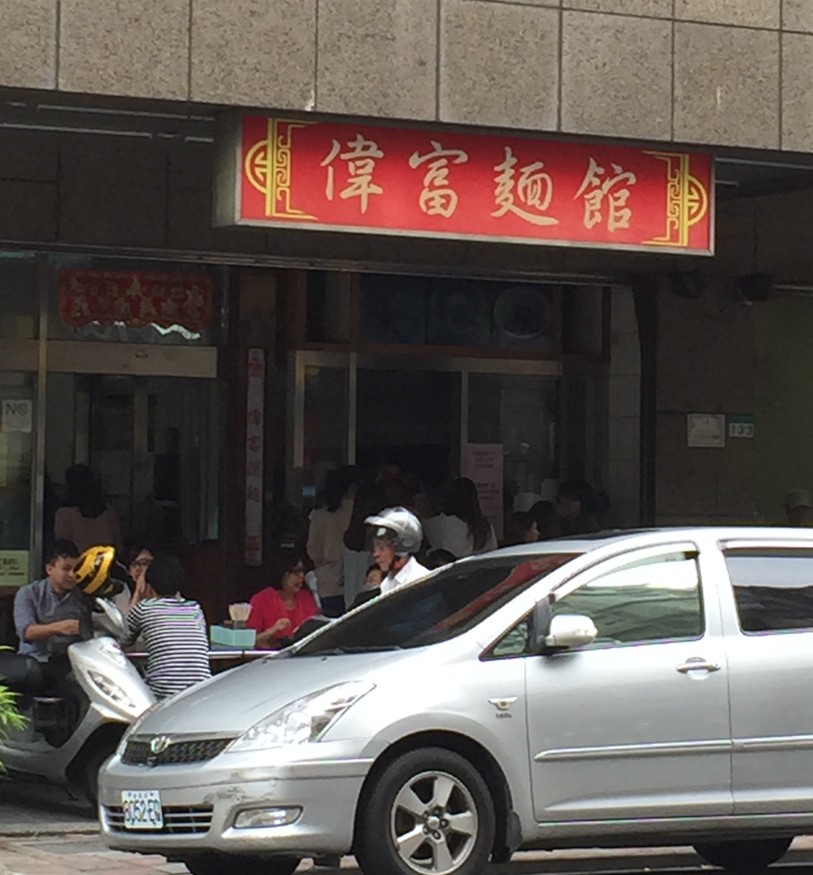

Slide 3
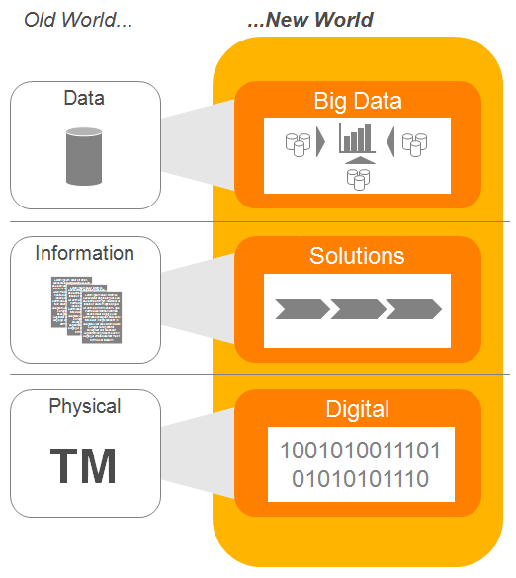
Digital and big data surrounding us
大數據就在我們身邊

Slide 4
Digital and big data surrounding us
Digital and big data surrounding us
大數據就在我們身邊

Slide 5
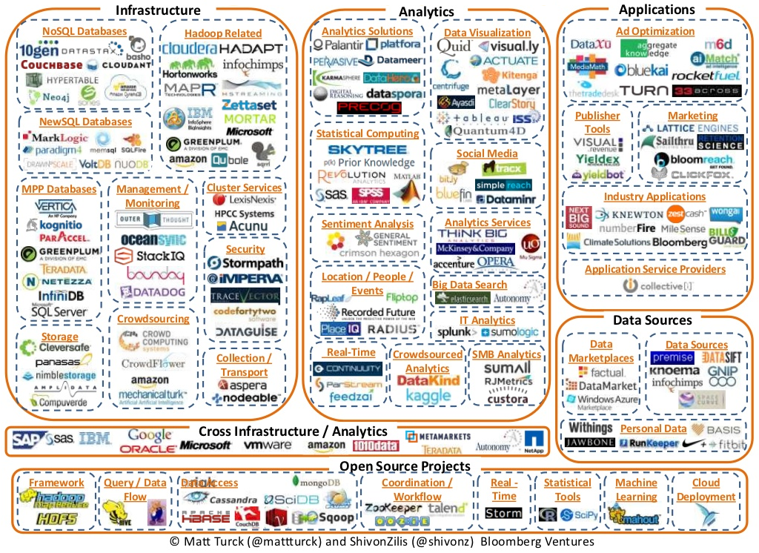
Digital and big data surrounding us
Digital and big data surrounding us
大數據就在我們身邊

Slide 6
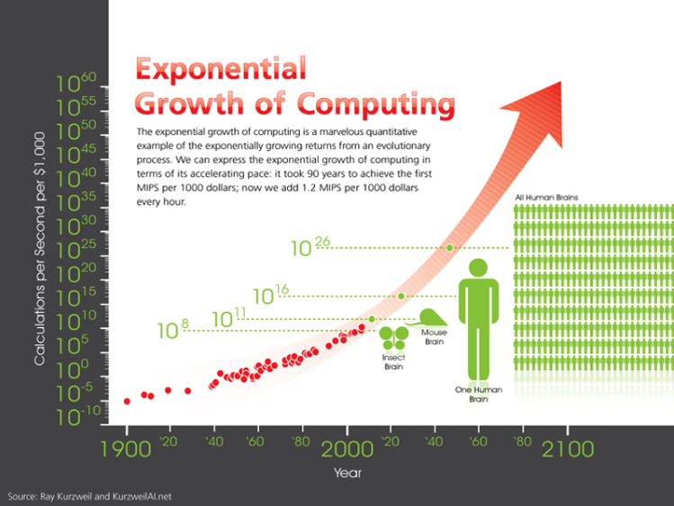
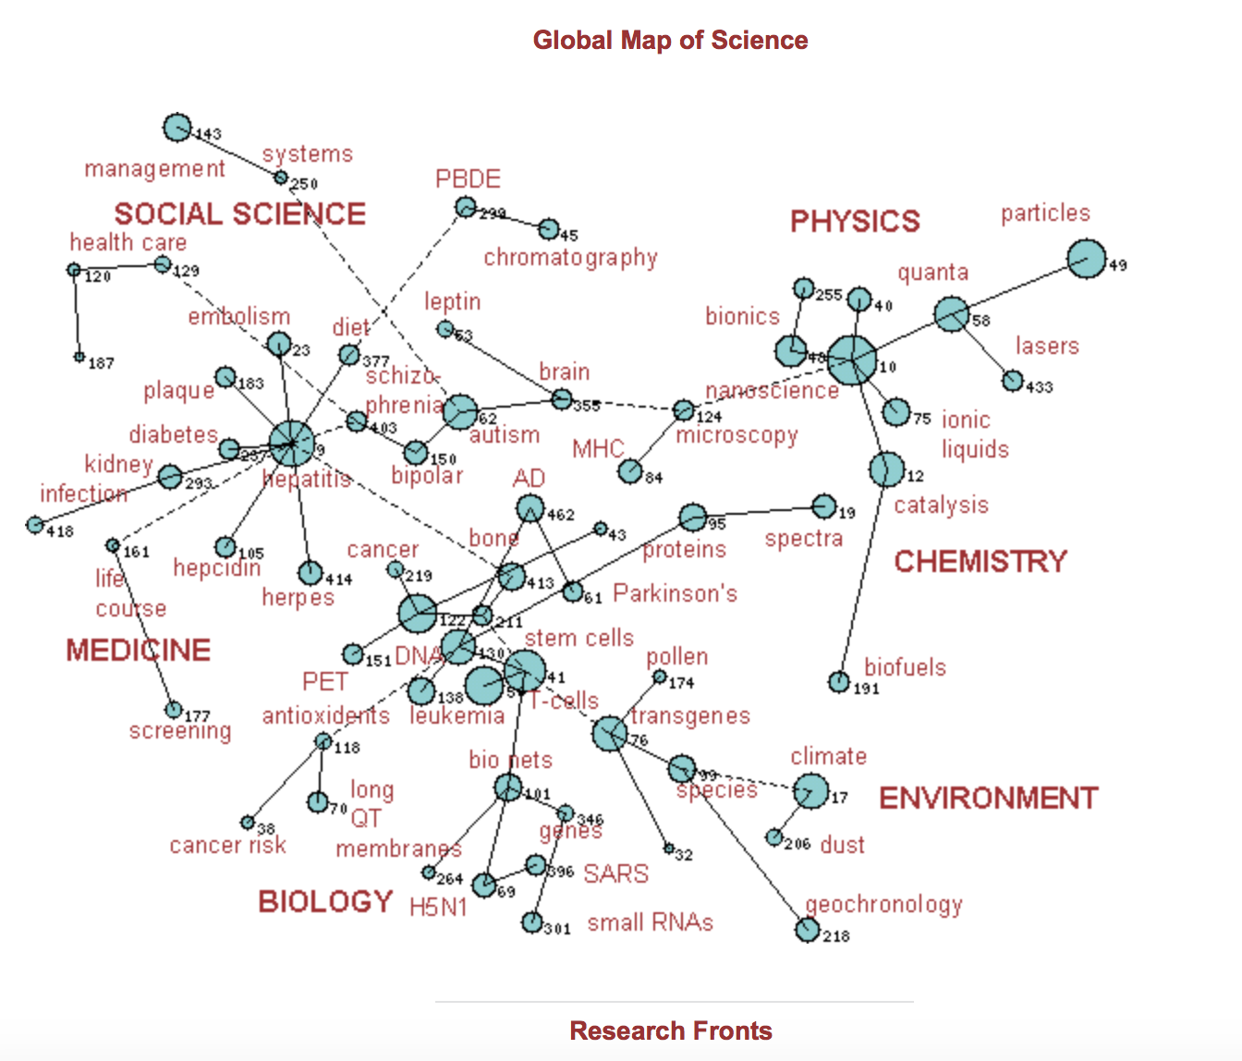
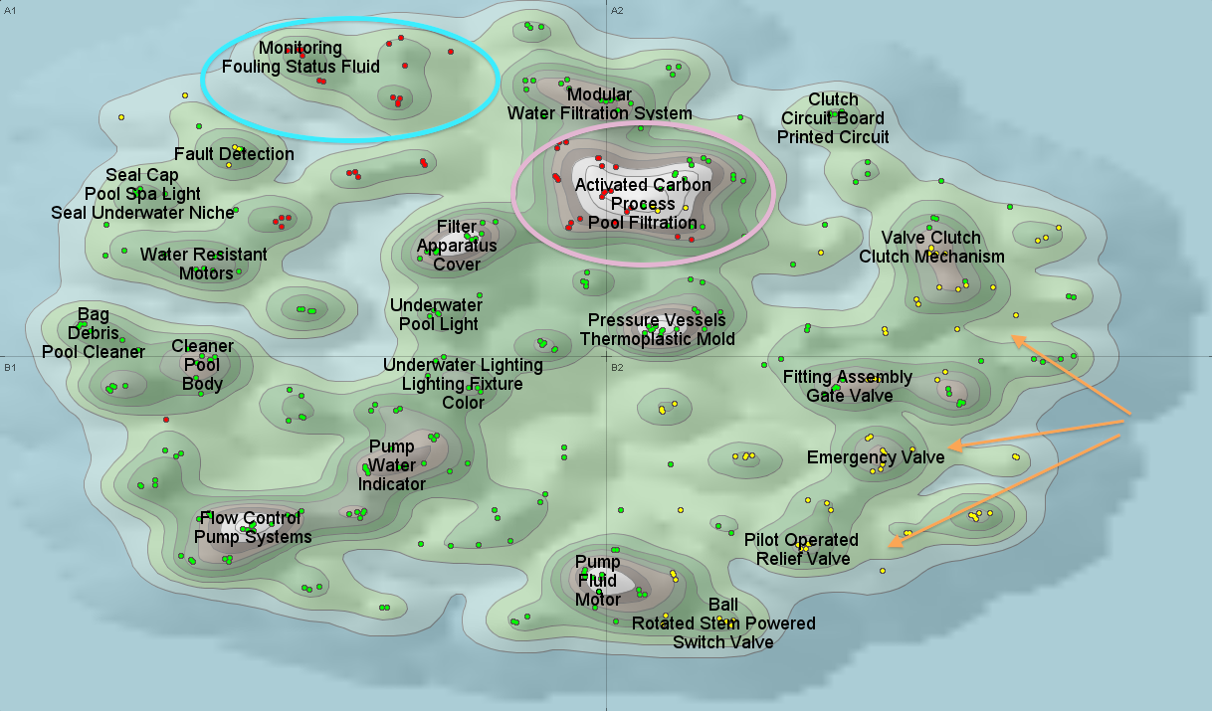
Information technology in the last 20 years
過去20年的資訊科技
Significant growth in computing power and supporting software
運算技術的快速發展
Major improvement in analytical algorithms
分析演算的改善
Substantial advances in visualization technology
視覺化科技的進步
We can process more information faster, and get more insights.
資訊能被更快速的處理與解讀
But we still don’t have the magic button!
但我們仍然沒有解藥

Slide 7
There are plenty of analytical tools
有許多分析工具
…. but are they the that you are looking for?
但他們是那個解藥嗎?
They tend to encourage the usage of publishers’ contents 鼓勵出版社內容的使用
Integration and customization will be additional cost of investment 整合或客製化是外加的服務
Interpretation is the real challenge 挑戰在於如何解讀

Slide 8
The major elements of analytics
分析的主要元素
Import
Manipulate
Analyze
Report
Sources
There are many ways to fragmentize the data and to analyze
多元的資料與分析方式
Commonly, we follow the knowledge flow from the data source, integration and ultimately, reporting
通常依循資料來源, 整合, 與統計的流程

Slide 9
Garbage-in-garbage-out
垃圾進, 垃圾出
Import
Manipulate
Analyze
Report
Sources
Sources: authoritative, editorial quality, reliability and selection criteria
可信賴的資料來源與選擇條件
Data structure and data homogeneity
資料結構與均一性

Slide 10
Organizing the data
資料的組織
Import
Manipulate
Analyze
Report
Sources
Extraction: NEL (Named Entity Recognition) and NLP (Natural Language Processing)
擷取: 專名識別與自然語言處理
Cleaning: Disambiguation, rule sets, fuzzy string matching, manual editing
清理: 更正錯誤、條件設定、編輯等
Mashup: Usually we can do it with API. But working with hybrid content can be complex
混搭: 通常可使用 API

Slide 11
Transforming data into insights
轉化資料為知識
Import
Manipulate
Analyze
Report
Sources
Analysis: Navigate, interact, cluster and visualize
分析: 操作, 叢集, 與視覺化
Visualizations: For exploration or communication?
Exploration: making decision, facilitating a discussion, etc.
Communication: “what would you show to your boss?”
視覺化以幫助發現與溝通, 幫助決策與資訊傳遞

Slide 12
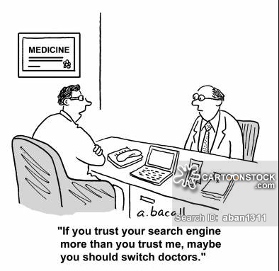
How to decide on the right tool?
如何判別正確的工具
There is no “one size fits all” when it comes to data analysis
沒有一鍵適用的工具
You need both “impose order” by the tool, and “self-organize”
利用工具, 也要有自我的組織
Always remind yourselves that you have all the data, and you need them all come together. Don’t forget about your Institutional Repository
運用手邊所有資料, 包含機構典藏

Slide 13
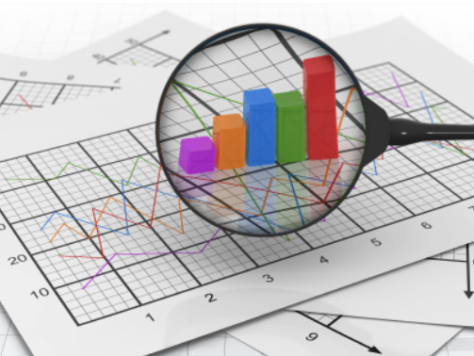
What’s the perfect tool?
完美的工具?
From a snapshot to a dashboard
從快照到資訊面板
“If you can’t measure it, you can’t manage it”: It’s about making decision at different phases and stages
可在不同階段支援決策
It’s about goal-oriented assessment and evaluation > Improve the research output, raise the quality of research
目標導向的評量, 增進研究產品與品質
Best practices in every part of the workflow!
每個工作階段的最佳化

Slide 14
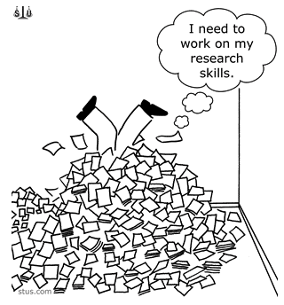
What are the best practices?
最佳典範?
Identify the objectives
Review the literatures
Specify the purpose
Collect data
Analyze & interpret
Write the interpretation
Best practices:
Smart discovery
聰明發掘
Originality check
原創性檢驗
Feedbacks
回饋
Reference management
參考文獻管理
Peer review
同儕評鑑

Slide 15
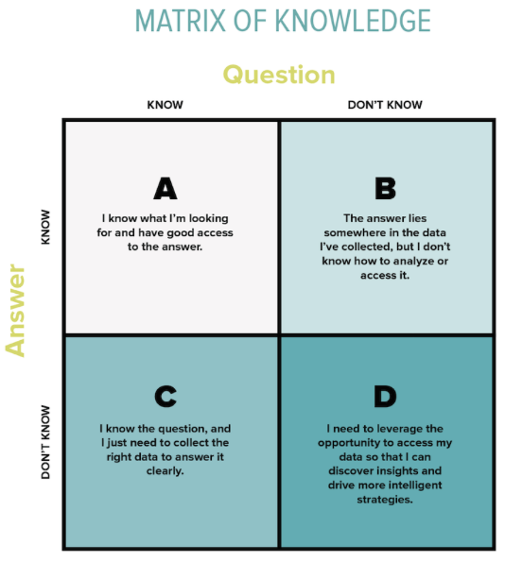
Smart discovery 聰明發掘
In the ocean of knowledge (like Google), researchers need to be skillful in discovering and not searching. 要發掘而非搜尋
Authoritative source: For example, peer reviewed journals
權威的資料來源
Connect to the right dots: Within the trusted source, explore the references/citations. All the best experts are within the community
連到對的點
Multi-disciplinary: Research is evolving into multi-disciplines with multi-trajectories. But we need to listen from the experts with reliable evidences!
跨學科

Slide 16
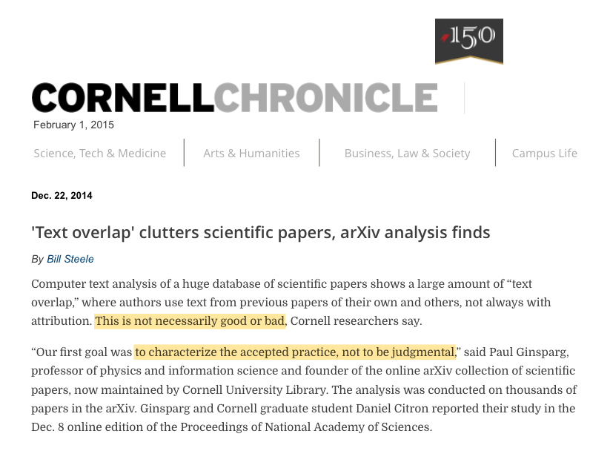
Originality check 原創性檢驗
It’s not surprisingly common to find “overlapping” or similarities in the ocean of information even across disciplines
重複常常發生
Though potentially this will generate noises, the output doesn’t influenced by any form of clustering or citation indexing
結果不會受叢集或引文影響
Minimize unintentional plagiarisms and enhance innovative thinking
確保並促進原創思考
Source: Bill Steele, “’Text overlap’ clutters scientific papers, arXiv analysis finds”, Cornell Chronicle, February 2014 http://www.news.cornell.edu/stories/2014/12/text-overlap-clutters-scientific-papers-arxiv-analysis-finds

Slide 17
Feedbacks 回饋
Feedbacks to improve the ideas
Peer reviewed versus non-peer reviewed publications
同儕評鑑與非同儕評鑑之出版品
Almost all scholarly journals are peer reviewed publications
Examples of non-peer reviewed publications are magazines, trade journals, etc.
Peer reviews versus feedbacks
同儕評鑑與回饋
Peer reviewing is essential to validate the contents by the expert of the same fields
Feedbacks is collecting ideas & opinions from the community. It’s still in the stage of ideation
Identify the objectives
Review the literatures
Specify the purpose
Collect data
Analyze & interpret
Write the interpretation
Community
Peer reviews to validate
Publication

Slide 18
Reference management 參考文獻管理
Objectives 目的:
To acknowledge the work of others
To demonstrate the body of knowledge on which you have based upon
To enable researchers to trace your sources for more information
To indicate the thoroughness of your literature review
Challenges 挑戰
There are many reference management software in the market
Lack of integrated platform to gather all the best practices of authoring in one place
Write
Integrated platform
Reference management
Community platform
Search
Originality check
Peer review process
Dissemination

Slide 19
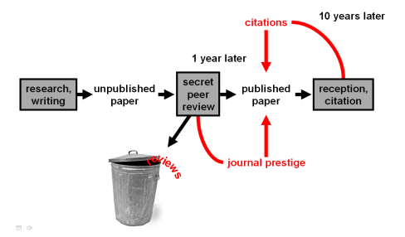
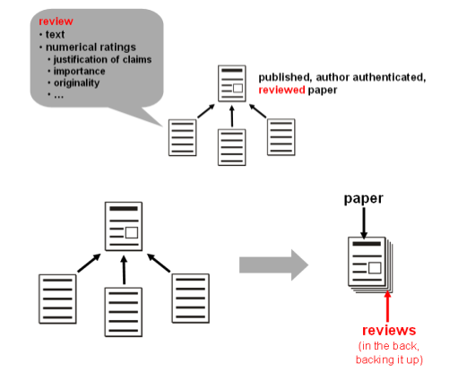
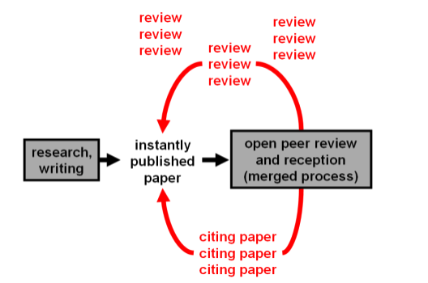
Peer review 同儕評鑑
Current
Source: The future of scientific publishing: ideas for an open, transparent, independent system https://futureofscipub.wordpress.com/2009/11/12/open-post-publication-peer-review/
Post-publication open review

Slide 20
The ideal publishing workflow
理想的出版流程
Write
Authoring platform
Reference management
Community platform
Search
Originality check
Peer review process
Scholarly community
The integration of both authoring platform and publishing platform will form a seamless automated publishing workflow with best practices being embedded
寫作平台與出版平台整合
The peer review process can be adjusted in accordance to the need with high transparency and more cumulated reviews from peers or experts
同儕評鑑透明化, 並與社群評鑑同步化
Publishing management
Publishing platform
Dissemination

Slide 21
Institutional repository (IR) and beyond
不只是機構典藏
Contents
Analytic
Technology
Insight
IR is not about technology, it includes less intangible aspects: building advocacy, determining policies and promoting research publication best practices
機構典藏幫助決策, 並倡導研究出版最佳典範
Lots of funding invested on acquiring e-resources, it’s a question of how to transform those contents from referencing to decision making
轉化內容, 以支援決策
Making a decision at the final output is too late. It’s about embedding best practices in the workflow with measurement to manage the progress
利用評量工具, 整合最佳典範, 管理工作流程

Slide 22
Thank you
woeifuh@igroupnet.com

