Slide 1
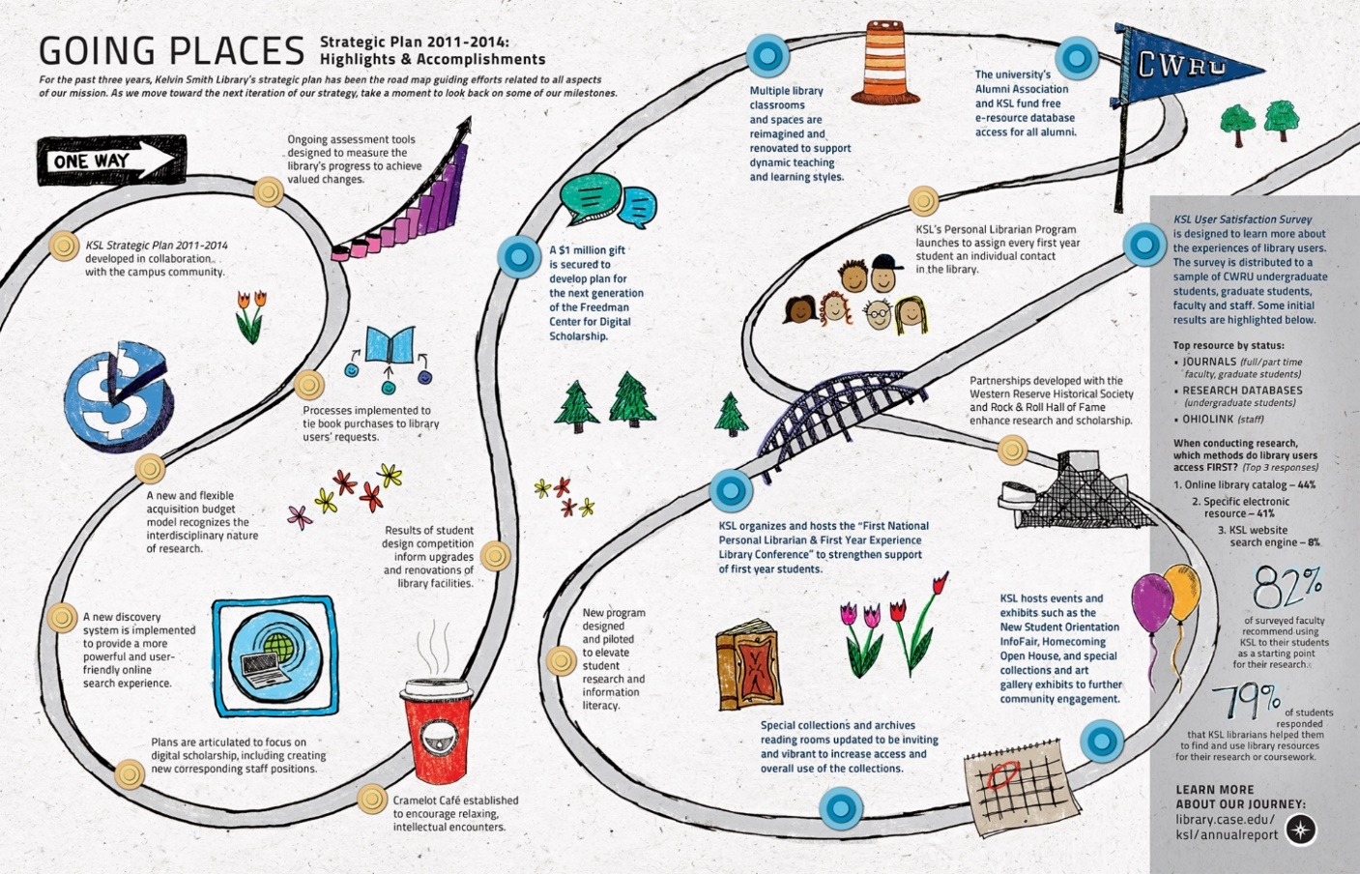
driving intentional change through strategic redesign
Arnold Hirshon
Associate Provost & University Librarian
Case Western Reserve University

Slide 2
Note: the slides appearing on the screen may be different from the translated slides in the packet distributed to you

Slide 3
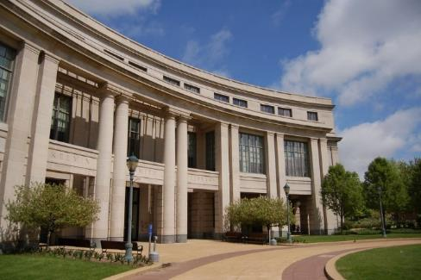
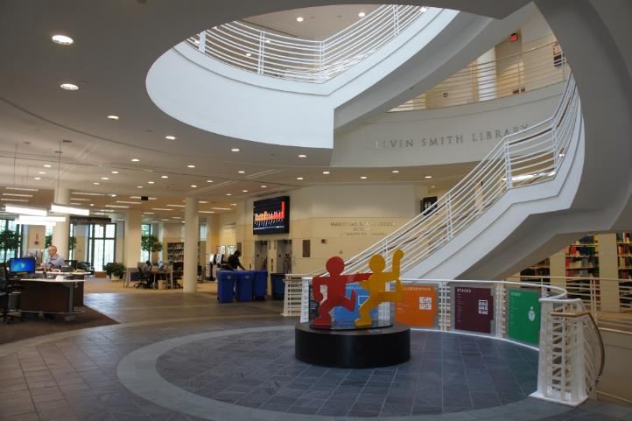
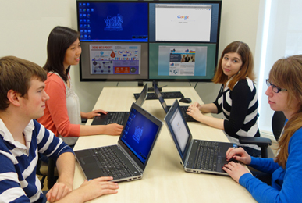
library strategic plan 1: 2011-2014
http://library.case.edu/ksl/aboutus/strategicplan/2011-2014/
plan 1: accomplishments overview
http://library.case.edu/ksl/aboutus/strategicplan/accomplishments2011-2014/
library strategic plan 2: 2015-2018
http://library.case.edu/ksl/aboutus/strategicplan/
plan 2: knowledge ecosystem of today and tomorrow
http://library.case.edu/ksl/aboutus/strategicplan/theknowledgeecosystem/
Case Western
Reserve University
Library Strategic Plans

Slide 4
how to succeed: my message to staff in 2010
listen carefully
plan strategically
engage in spirited, open, respectful dialog
ask difficult questions
propose daring solutions
experiment and take prudent risks
hire and retain great people
work as a team
be accountable
keep a sense of humor!
achieve results

Slide 5
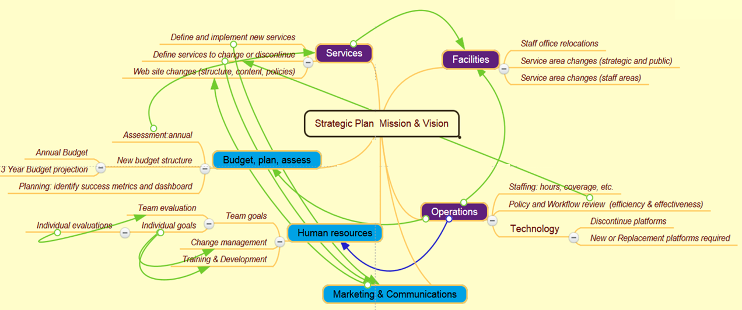
achieving strategic change is complicated
good ideas + great people + discipline = success

Slide 6
the pace of change: moving from old to bold
Regressive
Stasis
Incremental / Evolutionary
Transformative
Radical /
Disruptive
Libraries
Speed of
change
Glacial [Universities]
Business
Sound
Light

Slide 7
change: causes and potential
cause of change
accidental
opportunistic
intentional
point of
origination
anyone, anytime, anywhere: “stuff happens”
external to library
library choice
library strategic or operating plan
sources
(examples)
budget cut
bad technology introduction
vendor
univ. admin.
new idea
new staff
library goals, objectives,
action plans
type of change
rarely strategic
tactical; potentially strategic
strategic

Slide 8
the process all three steps must remain in harmony
Envision comprehend
Execute
implement
Engage
plan

Slide 9
strategic plan 1: the process in a nutshell
Research
Adjust
Plan
Implement
Develop
research through rapid experimentation
make adjustments before determining plans
plan for action
implement through redesign of the organization
develop new services and operations

Slide 10
our planning process in brief
Scanned environment
Defined mission, vision, values
Established goals and objectives consistent with those of the university
Communicated with library clients and library staff
Created success metrics (data gathering and reporting)
Redesigned the organization (redefined positions, reassigned staff, hired new expertise from the outside)
Created new budget structure and reallocated to priority items
Pursued or created new strategic opportunities
Renovated facilities to achieve objectives
Lived the plan!
Assessed success and how to build upon success
an iterative process with overlapping activities, not a strict chronological order

Slide 11
our strategic planning context
inform
Environmental
Scanning
Assessment
assess
investigate
Content
Services
Facilities
Staffing
Budget
Technology
integrate
instruct
Marketing
& Advocacy
Strategic
Planning
innovate
Project Management
Notes:
11
Outer ring: major process steps
Second ring: next level planning steps
Inner ring: outcomes / impact factors

Slide 12
Provide
Exceptional
Client Service
Be an
Effective Facilitator of Campus Partnerships
Demonstrate Value Through
Effective Operations
Drivers for Action
Innovation Through
Purposeful Experimentation
example:
a mission-based value proposition
Approach
Change Facilities to Be Inviting & Functional
Employ
New Service Delivery Modes
Expand Digital Scholarship Services
Strategic
Directions

Slide 13
strategic drivers and directions: 2011
if we are successful, we will achieve the vision to be the campus information laboratory for knowledge collection, connection, creation, and curation
to accomplish this, we will value
openness, collaboration, personalized service, and agility and innovation through experimentation
our mission is to be the knowledge and creativity commons of CWRU

Slide 14
2011 context – continued dedication to:
build and maintain strong scholarly information resources
foster faculty and student engagement and productivity in their intellectual pursuits
maintain a strong commitment to provide high quality services for our faculty and students
work collaboratively on campus and with other institutions to maximize the availability of information
retain a vibrant commitment to inclusion and diversity in programs, services and staffing
spoiler alert:
plan 2, goal 1!

Slide 15
our strategic imperative: to build a culture of agility and innovation through planned experimentation and continuous assessment

Slide 16
planning experimentation improvisation risk-taking communication resource allocation accountability assessment
strong execution is
fast, action-oriented, cost effective
and requires wise and continuous …
the willingness to take risks decreases with age, and people will choose a lesser reward over greater rewards that present higher risk
Notes:
Willingness to take risks decreases with age, and people will choose a guaranteed mediocre reward versus a high risk but high reward. A group of psychologists from Duke University led by David Paulsen looked at risk taking in the laboratory. Participants had the choice between either a guaranteed mediocre reward (say, four coins) or a gamble with a 50/50 chance of getting a low (e.g., two coins) or a high (e.g., six coins) reward. Paulsen and colleagues found adolescents to be greater risk seekers than adults. No matter how risky the gamble, adolescents choose it more often compared to adults. Source: Paulsen, D.J., Platt, M.L., Huettel, SA, & Brannon, E.M. (2012). From risk-seeking to risk-averse: the development of economic risk preference from childhood to adulthood. Frontiers in psychology, 3 PMID: 22973247 as found at https://brainsidea.wordpress.com/tag/risk-taking/

Slide 17
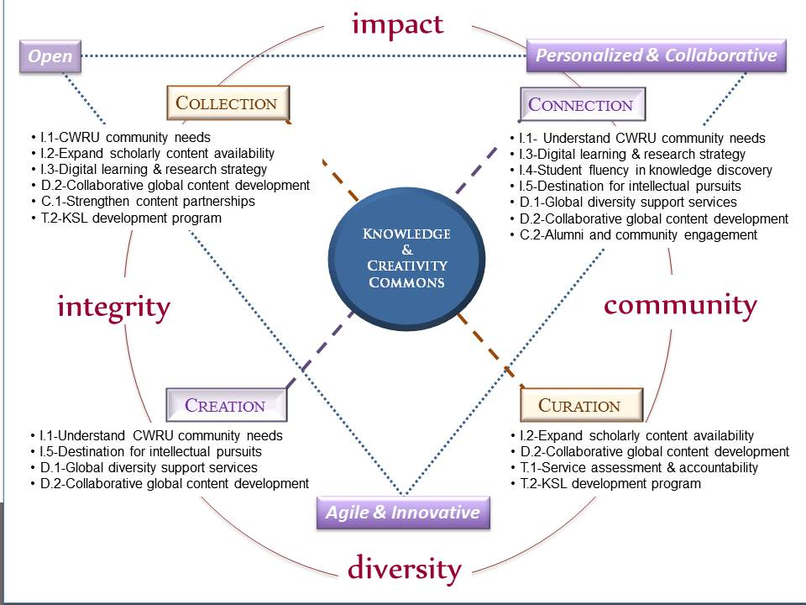
visualization of plan 1

Slide 18
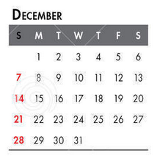
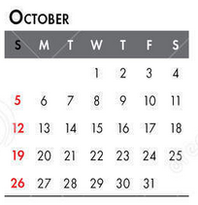
How RAPID? a brief chronology
Date | Event
December 2010 | Environmental scan
January 2011 | Mission, vision, values
February 2011 | Strategic objectives set
March 2011 | Campus open forums (March 2011)
April 2011 | Faculty Senate approval
June 2011 | Organizational redesign announced
July 13, 2011 | Mid-point update
September 7, 2011 | Organizational design announced
October 24, 2011 | New organization officially began

Slide 19
organizational redesign: critical factors and ideas
mission, vision & value driven
adopted strategic plan first, reorganized second!
inclusive and transparent process
aimed to achieve organizational agility
recognized that redesign requires change
engaged in intentional disruption
change = disruption + adjustment + ambiguity

Slide 20
how strategy drove organizational structure
Mission: the library is the knowledge and creativity commons of the university.
Vision: the library will be the information laboratory for knowledge collection, connection,
creation, and curation.
Associate Provost
& Univ. Librarian
Creation & Curation
Academic Engagement
Public Engagement & Library Admin.
Digital Learning & Scholarship Services
Research Services
Acquisition & Metadata Services
Scholarly Resources & Special Collections
Access & Delivery Services
Human Resources & Diversity Services
Planning, Budget & Assessment
Development
restructured organization around the new vision statement
eliminated positions no longer relevant
redefined and augmented some positions (teams and leaders)
Special Collections and Archives
Research Services
over 3 years reallocated positions to create new functions, e.g.,
Library Development Officer (fundraiser)
Marketing and Communications Officer
Budget and Planning Officer
Assessment Officer

Slide 21
aligned strategic directions with individual staff efforts
Organizational assessment
good ideas
+ great people
+ operational discipline
= strategic success
continuous organizational commitments
Priority 1
Priority 3
Organizational Priorities (projects, new operations)
Organizational Priorities (projects, new operations)
Goals
Goals
Priority 2
Priority 4
Portfolio of responsibilities
(job description)
annual goals
self-appraisal
supervisor’s appraisal
peer and 360 feedback
Individual performance
Individual Assessment *

Slide 22
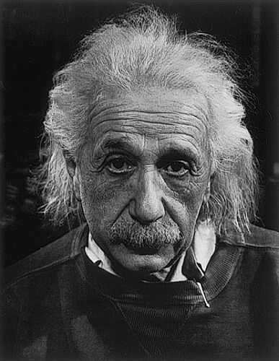
Redefined evaluation and promotion criteria
Job Performance
competency and consistency of performance
specific requirements are outlined in the job description and annual goals
Professional Knowledge, Abilities, Skills
education and training
experience
grasp of professional methods
command of one’s subject
continued growth
Professional Contributions
regional, national, international
service in professional organizations
publications
presentation
consulting (non-remunerated)
Professional Qualities
inclusive
high integrity and transparency
effective steward
openness
collaborative
provide personalized service
innovative and willing to experiment

Slide 23
combined discrete tasks into a portfolio of broad responsibilities with individuals retaining discretion to balance responsibilities
general position objectives
numerous separate tasks combine into broad organizational functions and individual contributions
provide increased organizational flexibility
supplement generic descriptions with
small number of “specialist” descriptions
special descriptions for department heads

Slide 24
introduced a “balanced portfolio” concept Research Services Librarians (RSL)
all RSL’s have four basic areas of responsibility
collection management
instruction
research support
relationship engagement and management with faculty and students
specialized responsibilities may be added to the portfolio (e.g., for digital scholarship specialists)
C
I
RM
RS

Slide 25
performance assessment: process
self-evaluation to assess personal performance against
job description
goals
annual activity report
external factors
summative statement
supervisor evaluates against all points above, focusing on
achievements
areas of excellence
areas for growth or in need of improvement
long-term development needs

Slide 26
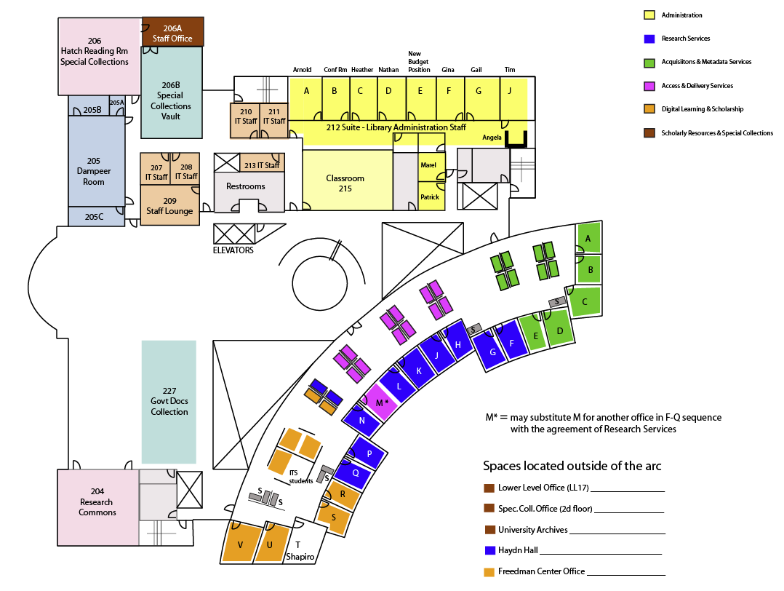
organizational redesign: offices relocated to bring teams together
everyone moved to a new office or cubicle
teams could determine specific offices within defined zones
little or no furniture was moved from office to office
Notes:
[Nearly] everyone will be moving. Moving provides us with the opportunity to
reevaluate what we have done in the past by going through old files, books, etc.
decide whether what will still be relevant for the future or what to keep as a momento (even if it has lost its relevance)
New surroundings provide us with new perspectives that free up our thinking
New assignments must be decided within 2 weeks (Friday, December 9)
“Zones” have been created, most of which are in the arc
Within the zones, teams will work with their team leaders to decide exactly who will be sitting where
We hope each team will be able to achieve consensus on room assignments
If it becomes clear to the team and the team leader that consensus cannot be reached, team leaders will conduct lotteries to determine office / desk assignment
A few offices are outside the arc, but secondary open spaces may be available to those without arc locations
If decide earlier, you can start getting ready earlier – but the actual move still will not occur until the common move date of December 16
Little or no furniture will be moved
- In the few remaining cases where we have not updated furniture in some time, we will be considering upgrading the remaining office furniture – but this may not occur this fiscal year

Slide 27
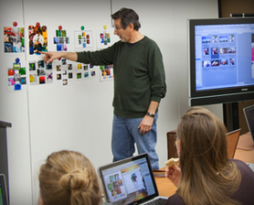
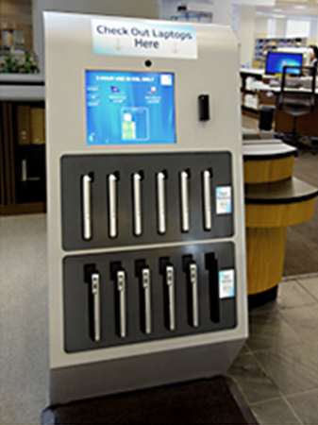
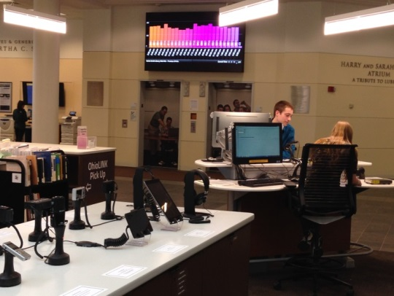
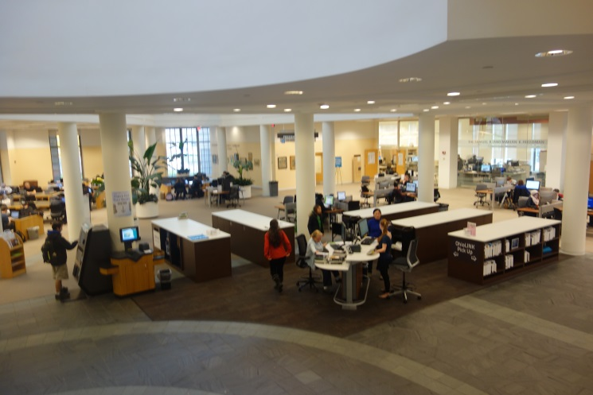
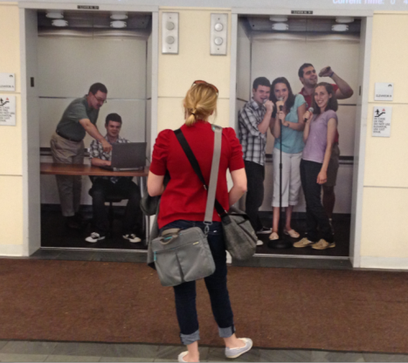
facility changes: 2011-2014 (partial list)
installed a new Welcome Desk and a new Service Center
new library café, art gallery, and art hung throughout the building
student contest to redesign the library resulted in service rezoning and all new signage
replaced tables and all chairs with mobile furniture throughout the building
redesigned and expanded all classrooms for active learning
opened a graduate student Research Commons
installed technology in all student collaboration rooms
modified the digital scholarship center
replaced all public computers
installed a laptop vending machine
created an equipment checkout display counter
enhanced leisure reading collections
upgraded the Public WOW display
created fun new elevator doors

Slide 28
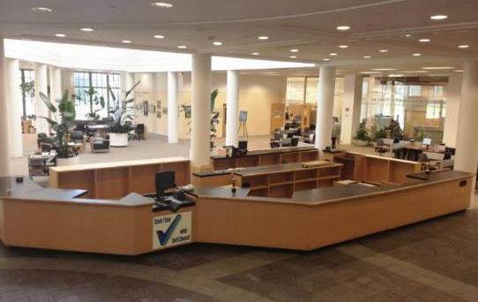
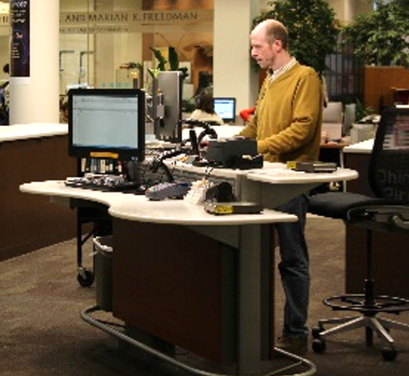
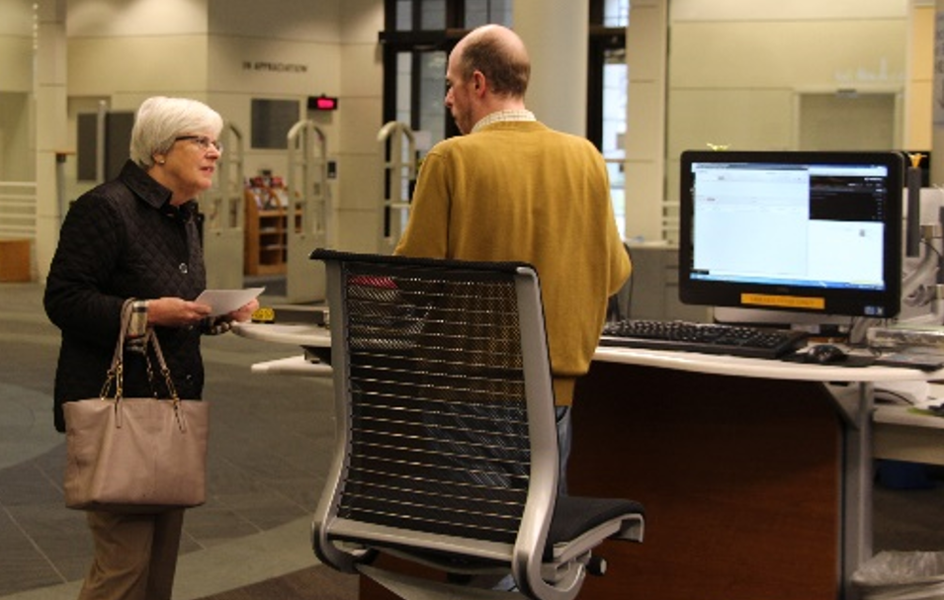
engaging client environments
before
after
replaced
“behind the fortress” model with
“working alongside” services
Notes:
A long overdue project was getting rid off the giant and unfriendly circulation desk. It was unwieldy for both staff and patrons, it faced in the wrong direction (toward the elevators, not toward the front door), and it was inefficient. It also took up far too much real-estate, and required most services to be staff-provided rather than self-service
Top is before, bottom shows how small, efficient, open and approachable it is now. We moved from a desk service model to a kiosk-model, and found an “off the shelf” table. We actually tried out at least three different desks and locations before adopting this one. At the front door we also added a Welcome Desk, which is not shown, so we could both greet users and gather user ID information from campus and community users – which has been a great source of data about our user population.
Also shows the laptop dispenser added front and center
This space is just inside the front door, to your left opposite the way to the cafe

Slide 29
engaging client environments
open and active areas to enable engagement with technology

Slide 30
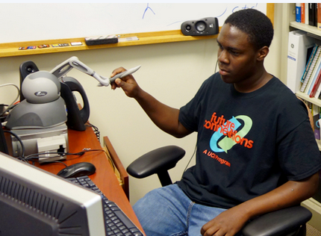
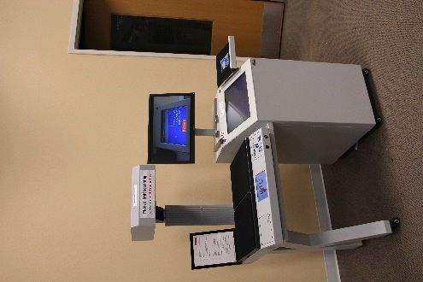
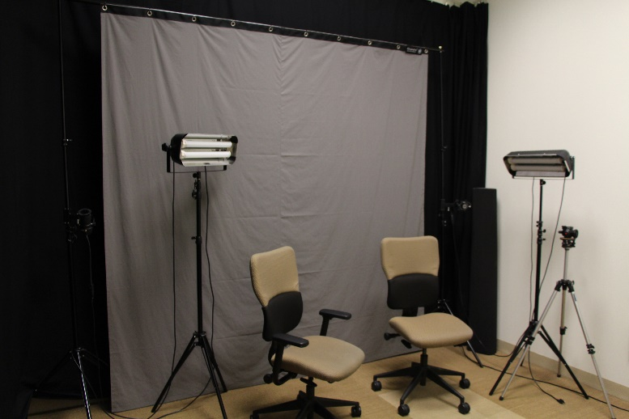
center for digital scholarship
3D scanning
open book
scanning
collaboration
spaces
student video studio

Slide 31
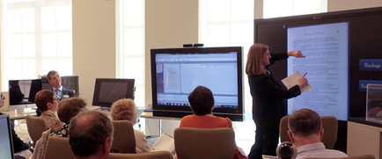
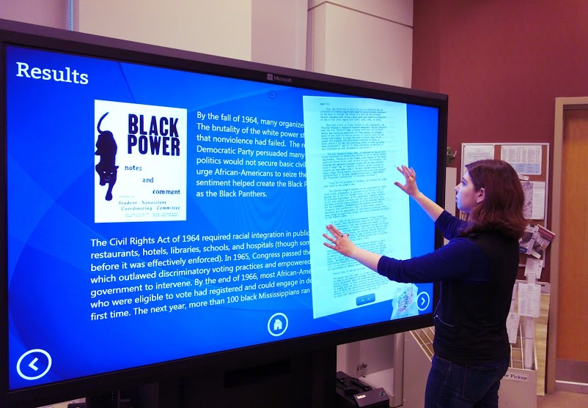
provide advanced technologies
data visualization
Notes:
Arnold can mention how the idea of the Visualization Wall remains good, but this particular solution – an ultra-high resolution screen with a huge amount of computing power behind it that requires significant programming experience to operate -- isn’t quite right for general library use.
We are working with ITS to have the system replaced with one that is wall mounted, is simpler to operate, and has bezel-less screens

Slide 32
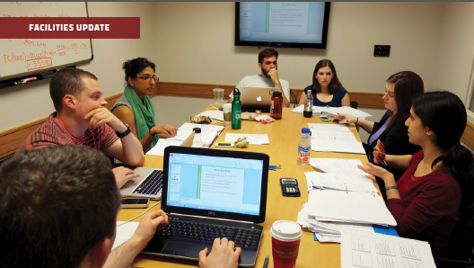
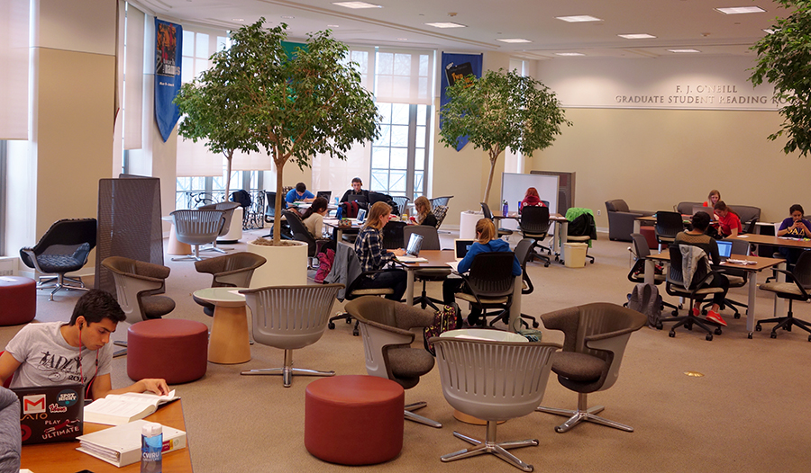
collaborative learning
before
after
Notes:
Before and after of the 2nd floor student study/seating area
Old looking, heavy oak furniture that was state of the art at the time because it included both electrical outlets and Ethernet jacks, has been replaced with a more eclectic and versatile combination of options and a wealth of floor outlets. An advantage of the original building design was that the public seating areas are all on raised flooring, making rewiring relatively easy.

Slide 33
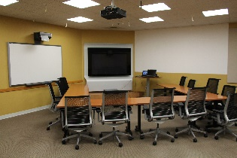
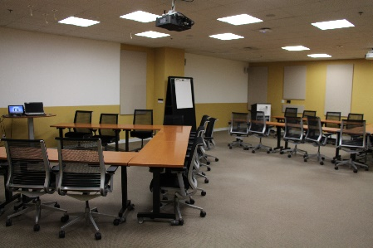
turned classrooms into active learning spaces
Notes:
This shows a 2nd floor computer lab that was similar to the one on the lower level. We transformed this one into a telepresence room
Again, previously a traditional PC classroom, now an interactive space with full interactive telepresence designed by CISCO. (note the next slide shows the other side of the room)
This was funded in partnership with ITS. We provided the space, the room renovation costs, and the non –telepresence furniture provided by the library. ITS provided all the hardware and installation.
This was entirely funded through University funds

Slide 34
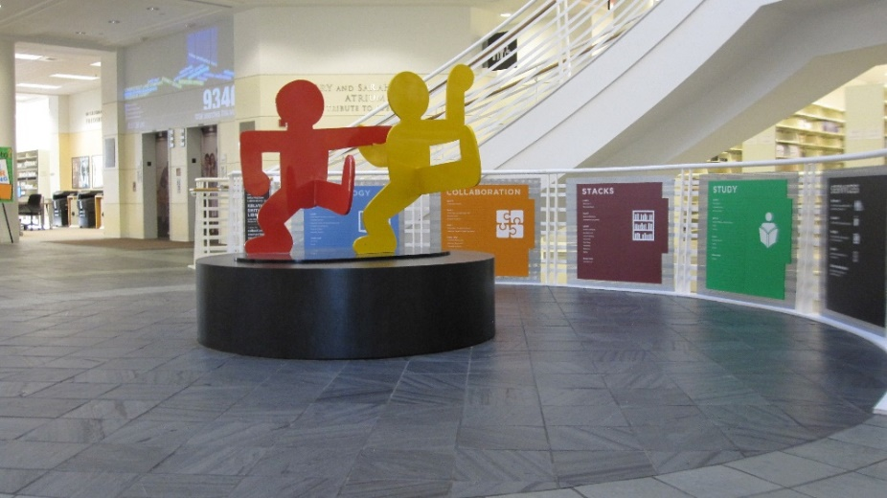
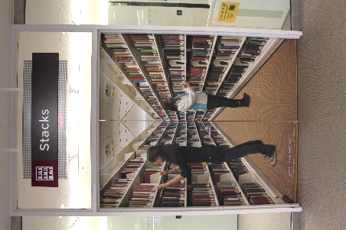
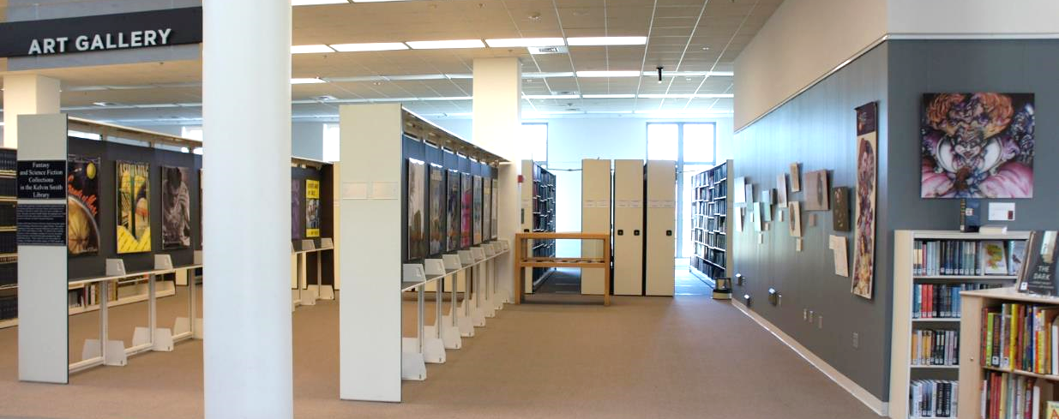
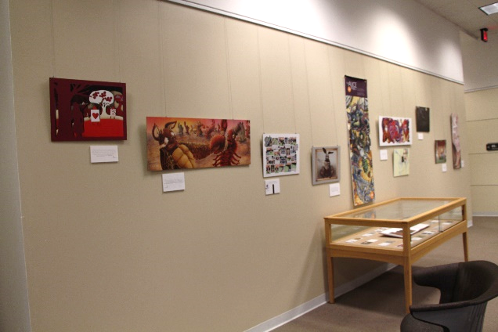
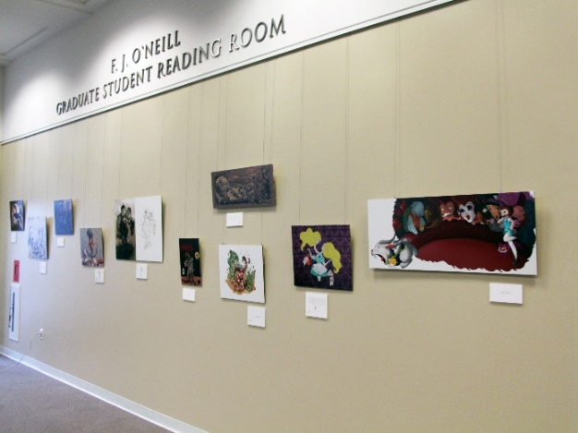
relaxation and fun spaces:
art everywhere
Notes:
Also done right away was to remove some of the stacks across from the café,
This was accomplished by removing several rows, and re-purposing shelving units as display cases. A very simple and inexpensive way to achieve a gallery in a prime location.
This is a low cost solution. We have modified it slightly, primarily to change the color scheme and added tracks for wires on one wall, but essentially this has been successful as is.
It may not be the fanciest solution, but it gets the job done.

Slide 35
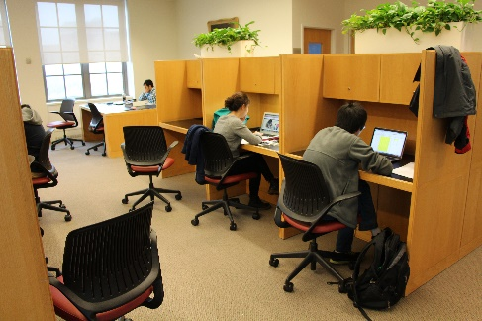
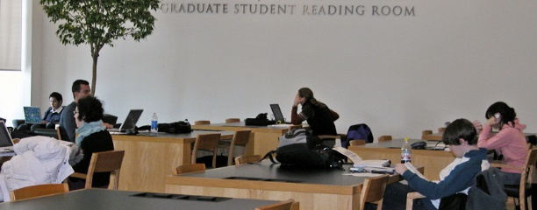
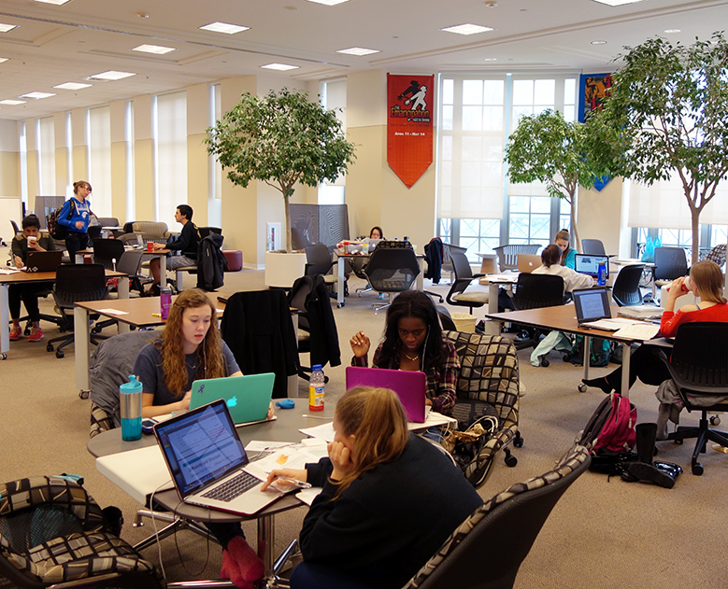
study
areas
before
after
Notes:
Before and after of the 2nd floor student study/seating area
Old looking, heavy oak furniture that was state of the art at the time because it included both electrical outlets and Ethernet jacks, has been replaced with a more eclectic and versatile combination of options and a wealth of floor outlets. An advantage of the original building design was that the public seating areas are all on raised flooring, making rewiring relatively easy.

Slide 36
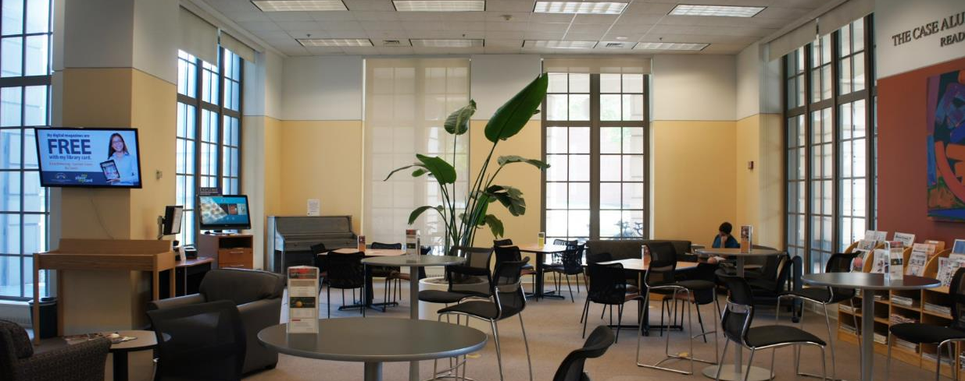
relaxation spaces: cafes and leisure reading
Notes:
The first thing we did was to open a café to signal that the library could be a place not only for study, but also for relaxation and opening of the mind.
Top pictures shows the formal environment before, and below is what’s there now

Slide 37
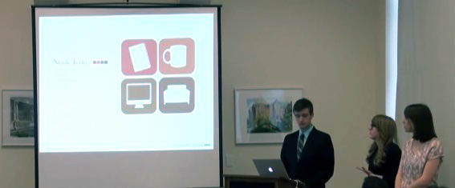
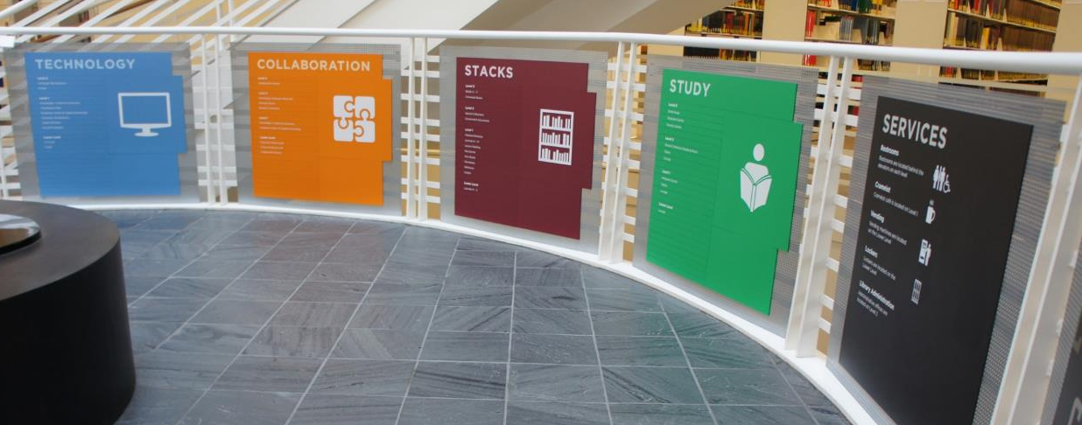
Installed new signage based upon a student team design
Notes:
Once the café an gallery were complete, we commissioned a student competition for ideas on how to transform the spaces. All of the teams that responded did a tremendous amount of research, from student surveys and focus groups to investigation of available furnishings.
All of the teams remarked at some point about the total lack of wayfinding in the building – a “design feature” from the original architect who thought that signage should be so subtle as to be non-existent – and the lack of adequate zoning of some of the operations of the library.
The top image is of the winning team during their presentation, which set forth a full plan (including logos, color schemes and content) for the signage. The bottom image is of the implemented signage solution that branded the reconfigured spaces, and added color.
This competition and solution became the roadmap for reconfiguring spaces in the rest of the library

Slide 38
used new lighting to highlight key services
Notes:
Along with the desk change was new, brighter lighting, added to highlight the space
The library also had a lending system for lots of tech equipment, and the simple idea of putting it on display made for a simple, intuitive way to both highlight want’s there and make it browsable.

Slide 39
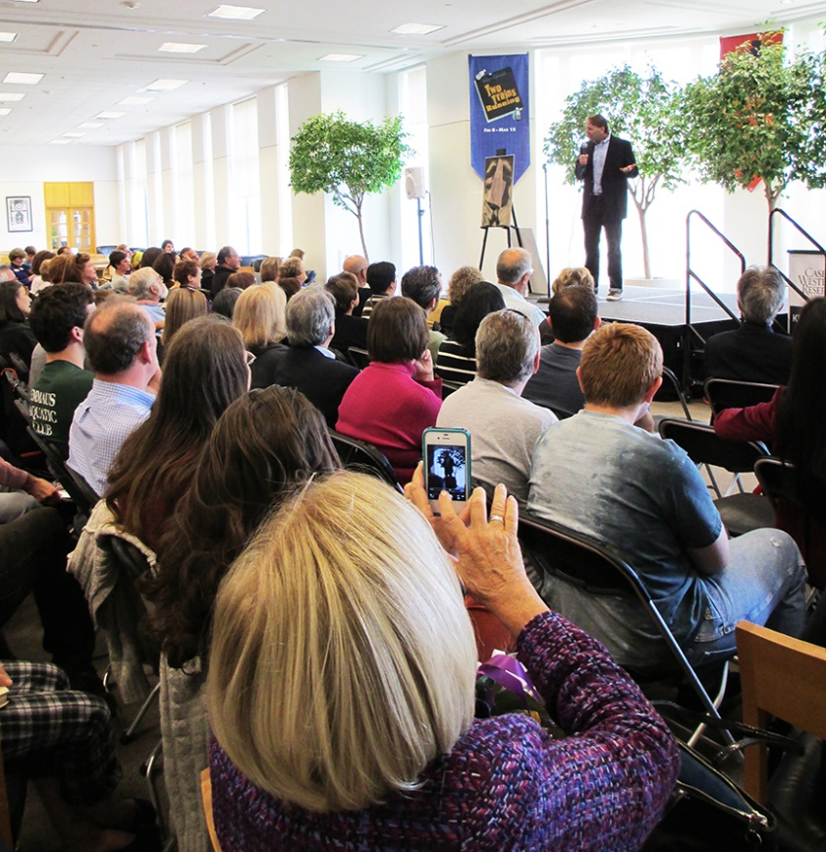
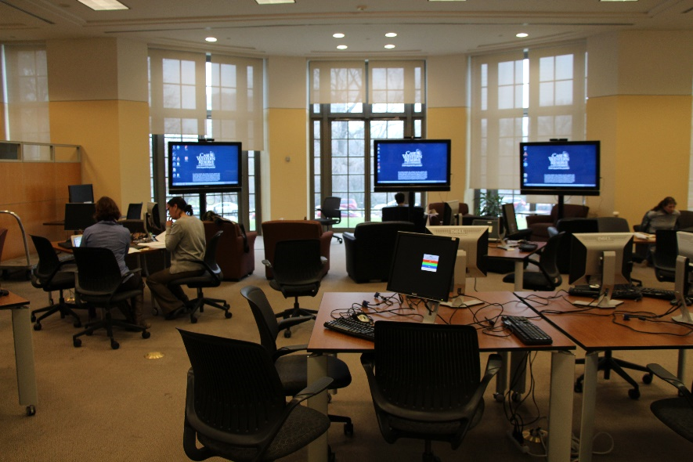
used public spaces for events

Slide 40
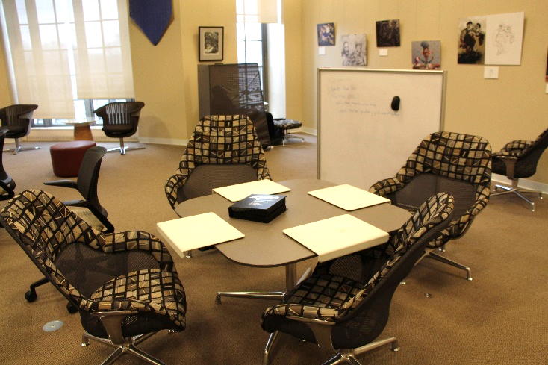
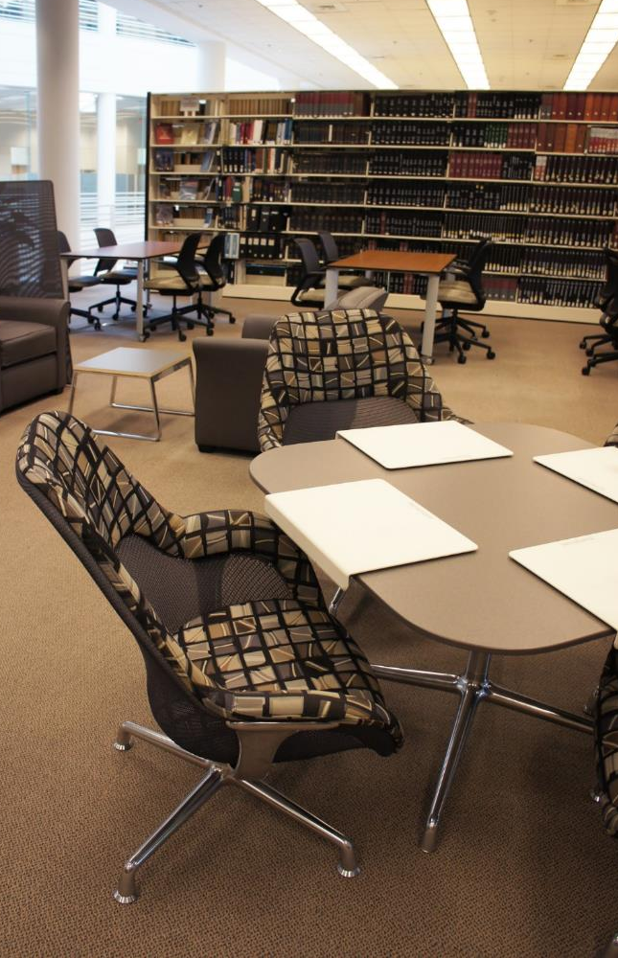
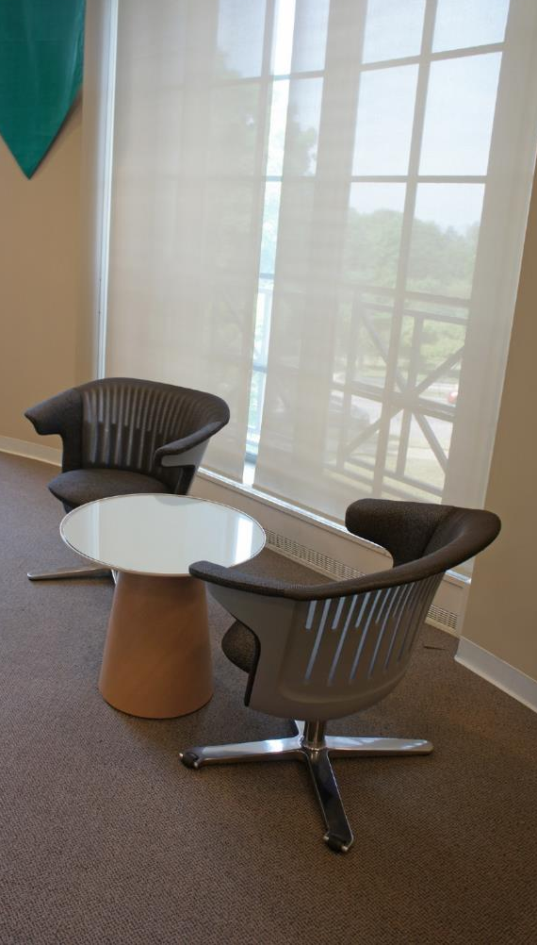
used mixed seating
Notes:
Our furniture, manufactured by Steelcase, and the floor design was developed in consultation with a local company.
We put out samples of different types of chairs and tables, and students had the opportunity to vote on what they liked and didn’t like.
Our color scheme is muted, contemporary, but also classic. I am not a big fan of loud colors that have a tendency to look dated very quickly.

Slide 41
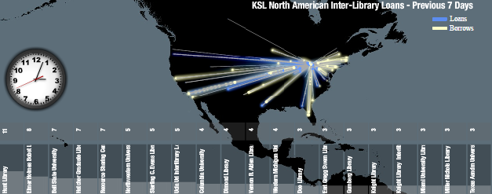
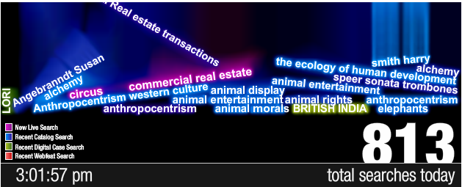
communications & engagement
annual reports
revived the library magazine (KSL Connects)
redesigned library website
staff meetings (progress reports; Q&A open forum)
strategic plan drafts issued for campus comment
public WOW display
monthly dashboards
held many events in the library
client surveys and focus groups
http://library.case.edu/ksl/aboutus/statistics/publicwow/illnortham/
http://library.case.edu/ksl/aboutus/statistics/publicwow/searchterms/

Slide 42
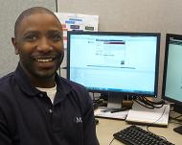
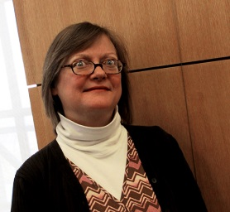
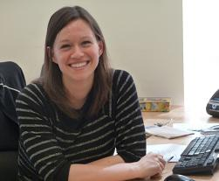
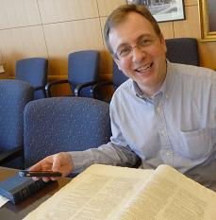
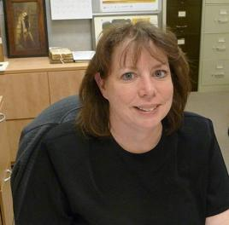
example: specific new opportunity not envisioned when plan was adopted
relationship to strategic objectives
increase student fluency in knowledge discovery and processing
become the campus destination for intellectual pursuits … by creating new service delivery models
program results

Slide 43
assessment: balanced scorecard strategy map
the mission and vision are the drivers of the map,
from the top down and the bottom up
Mission: the knowledge and creativity commons of the University
Customer Perspective
Financial Perspective
I.2. Expand availability of and access to scholarly content
I.3. Define and deploy a digital learning and research strategy
I.5. Become the campus destination for intellectual pursuits
T.2. Grow services through an expanded development program
I.2. Create a new library materials allocation formula
Create financially sustainable services
Collection
Connection
Creation and Curation
I.2. Expand special collections & explore opportunities to grow and use archival materials
C.2. Create a strategic alumni and community engagement plan
I.1. Transform service design & delivery by researching needs of CWRU community
C.1. Strengthen external content partnerships
I.4. Increase student fluency in knowledge discovery and processing
D.1. & D.2. Create and implement global resources and diversity plan
Learning
& Growth
Effectively implement reorganization and strategic plan implementation
T.1. Implement service assessment and accountability to the CWRU community
Vision: the information laboratory for knowledge collection, connection, creation & curation

Slide 44
strategy map example:
Research Services Team
Mission: the knowledge and creativity commons of the University
Customer Perspective
Financial Perspective
I.2. Expand availability of and access to scholarly content
I.3. Define and deploy a digital learning and research strategy
I.5. Become the campus destination for intellectual pursuits
T.2. Grow services through an expanded development program
I.2. Create a new library materials allocation formula
Create financially sustainable services
Services and Engagement
Collection
Connection
Creation and Curation
I.2. Expand special collections and explore opportunities to grow the use of archival materials
C.2. Create a strategic alumni and community engagement plan
I.1. Transform service design & delivery by researching needs of CWRU community
C.1. Strengthen external content partnerships
I.4. Increase student fluency in knowledge discovery and processing
D.1. & D.2. Create and implement global resources and diversity plan
Learning &
Growth
Effectively implement reorganization and strategic plan implementation
T.1. Implement service assessment and accountability to the CWRU community
Vision: the information laboratory for knowledge collection, connection, creation & curation

Slide 45
example of measures of success of relevant strategic objectives: Research Services Team
Customer Perspective
Strategic Objective I2: Implement a strategy to grow relevant and valuable collections that support teaching and research
 | Initiative | Citation analysis of the publications of CWRU recently-tenured faculty and dissertations of CWRU graduate students to measure usage and access to sources from CWRU physical and online resources.
 | Measure | Percentage of works cited that are available through CWRU libraries and online access.
 | Target | First year: 80% of content cited is available through CWRU libraries (physical and online) to establish baseline. Future year's goal: increased percentage and possibly separate book vs. journals comparison.
 | Initiative | Analysis of OhioLINK and ILL requests made to determine collection gaps so purchasing decisions can be made to add materials in those subject areas.
 | Measure | List of items with multiple requests including number of requests, plus price of ILL versus ownership.
 | Target | 100% handling by RSLs and decisions made on all items with multiple requests.
Services and Engagement Perspective
Strategic Objective I4: Increase student fluency in knowledge discovery and processing
 | Initiative | Develop a new curriculum that will enhance student fluency in knowledge discovery and processing.
 | Measure | Number of classes offered for formal instruction; number of tools/platforms developed; assess improvement of students work on papers, tests and/or projects.
 | Target | 20% increase of users reached through instruction efforts each year; First year: establish baseline of improved student performance on assignments, research, and other work products.

Slide 46
balanced scorecard implementation
created dashboards based upon the balanced score card
implemented a 3-year budget plan to establish funding for each strategic objective
embedded organizational objectives and success metrics in individual staff performance goals
regularly assessed progress and refine metrics based upon experience
hired a full-time assessment officer

Slide 47
plan report card: mid-point evaluation
Goal 1: Impact
Objective | Grade
Understand CWRU community interests & needs | A
Expand scholarly content access & availability | B +
Define and deploy digital learning and research strategy | A -
Increase student information fluency | B +
Become the campus destination for intellectual pursuits | A -
Goal 2: Diversity
Objective | Grade
Define services to support global diversity | B +
Promote collaborative international content development | B
Goal 4: Integrity and Transparency
Objective | Grade
Assess services & be accountable | A -
Create a KSL development program | A -
Develop a new library materials allocation formula | A
Goal 3: Community
Objective | Grade
Strengthen content partnerships | B
Increase alumni and community engagement | A-

Slide 48
strategic plan 2011-2014: final assessment
Expanded availability of scholarly content by launching the Summon discovery layer, implementing demand driven acquisitions, defining a new collections budget allocation formula, reaching agreement on print volume deaccessioning, working with a company external business to build a shared high density storage facility, and becoming a member of the HathiTrust
Expanded library special collections with major new acquisitions, holding a national colloquium about special collections, and increasing the number of undergraduate and graduate classes taught using the collections
Deployed a new digital learning and research strategy through a partial redesign of the digital scholarship center and securing a $1M donor gift to expand its services, redesigning the institutional repository, and working with campus partners to collaborate on providing digital scholarship services
Increased student fluency in knowledge discovery and processing with the introduction of a Personal Librarian program for first-year students
Reinvigorated KSL as a physical and virtual destination by opening a library café, implementing student competition recommendations, replacing all public area chairs and most tables, and creating an art gallery
Increased development by raising $10.1 million against a $15 million goal

Slide 49
Strategic Plan 2: 2015 – 2018 building upon success

Slide 50
plan 2: strategic directions
Underpin Research
Essential content & resources
Incubate digital scholarship starting with Freedman Center redesign
Enrich Learning
Quality physical and virtual services and spaces
Distinctive special collections
Advance Shared Services
Consistent & coordinated campus library experiences
Collaborate with non-CWRU partners
KSL Vision:
Information laboratory of knowledge collection, creation, connections,
& curation

Slide 51
alignment of 2011-2014 and 2015-2018 objectives
2014
Understand community interests & needs
Expand access to scholarly content
Define and deploy a digital learning and research strategy
Increase student fluency in knowledge discovery and processing
Become the campus destination for intellectual pursuits
Define services and resources to support global diversity
Promote collaborative international content development
Strengthen content partnerships
Increase alumni and community engagement
Continually assess services
Build a new fundraising/development program
2018
Increase access to purchased content
Be the incubator of digital scholarship on campus
Expand use of special collections
Expand library engagement with faculty
Increase efforts in scholarly communications, and use of open access content
Provide dynamic and inspiring physical and virtual spaces
Design a radically new digital and information literacy program
Ensure library review of proposals for new academic degrees and programs
Expand Personal Library program so all users have and know their personal librarian
Create consistent campus library experiences
Expand partnerships with other campus service providers and non-CWRU organizations

Slide 52
examples: multi-year implementation planning
 | 2015 | 2016 | 2017
Objective 1: Purchased content | Shift collections (stacks & storage) Develop new strategies for advocating budget increases New metrics on faculty use & impact Publish faculty wishlists New e-books strategies | Direct marketing of new purchases Generate more restricted endowments | Generate more restricted endowments Obtain increased funds to purchase content
Objective 2: Digital Scholarship | Complete Freedman Center redesign | Publicize Center as innovation hub for campus Create digital preservation plan Develop data management policies | Introduce new technologies
Objective 3: Special Collections | Increase digitization efforts Accelerate EAD finding aids Complete cataloging of backlog | Work with faculty to increase use of primary resources in the curriculum Use RSLs to market special collections Review collection development policy | Solicit donors to help us build 21st century collections

Slide 53
facilities

Slide 54
digital scholarship center redesign

Slide 55
envisioning the role of game changers
Improve the discovery experience
Improve retention and delivery of print materials
Implement the comprehensive discovery & delivery plan
Opportunities
Enrich Summon to become the sole search tool (including library catalog)
Harvest into our catalog records from other local cultural organizations (e.g., art, history, & natural history museums)
Expand user requested e-book acquisitions
Opportunities
Transfer materials all stored materials into the new shared Cleveland print repository
Use stacks to maximize monographic holdings
De-duplicate multiple print copies
Relocate or deaccession print journals that have trusted electronic & print repository backup
Build and enrich new special collections for the 21st century
Opportunities
Prepare planning assumptions re: consolidating collection & service points
Revise storage principles
Generate implementation plans
Create timetables for action
Expedite implementation by outsourcing special tasks
Relocate and deaccession consistent with approved principles

Slide 56
relationship of game changers to strategic plan 2
Goal 1, Objective 3: Special Collections [A a new vision for the 21st century … fostering distinctive and unique content]
Goal 1, Objective 4: Research Services [Integrate library into the research process]
implement the comprehensive discovery & delivery plan
Goal 3, Objective 1: Consistent Campus Library Experiences
Goal 3, Objective 2: Partnerships with CWRU and Non-CWRU Organizations
Goal 2, Objective 1: Library Spaces [Campus master plan]
Goal 2, Objective 3: Services [Systematically assess and improve services]

Slide 57
and watch your strategic vocabulary

Slide 58
“[I]n most matters it is more important that the applicable rule of law be settled than that it be settled right... This is commonly true even where the error is a matter of serious concern…” Justice Louis Brandeis, dissent, Burnet v. Coronado Oil & Gas Co., 285 U.S. 393 (1932)
don’t just plan … do!

Slide 59
inclusive processes involve the community to develop a collective vision and comprehensive direction
successful planning process: things to remember
Culture eats strategy for breakfast [quote attributed to Warren Buffett]
great goals can be ruined through poor execution
strategic plans should be flexible enough to enable you to seize and incorporate unanticipated strategic opportunities

Slide 60
questions and comments? Arnold Hirshon Associate Provost & University Librarian Case Western Reserve University arnold.hirshon@case.edu

