Slide 1
Knowledge Hub＠NTHU 知識匯：創新思維翻轉知識舞台
林福仁
國立清華大學圖書館
服務科學研究所
05/04/2015

Slide 2
Some Observations

Slide 3
Within an arm’s length (咫尺天涯)
Plagiarism checker
One day, Prof. Yang came to me to share his initiative to create a plagiarism checker using the encrypted text as the input, so that it protect the authors’ intellectual property. He would like to take the thesis repository as the test set.
I mentioned this request to the deputy director, Prof. Sun, and found out that Prof. Sun actually has built a system to be able to encrypt the plain text for plagiarism checking.
→I need a quick reference of each professor’s up-to-date academic profile.

Slide 4
Indirect link (一切都是緣分)
One day, Qian-min, a master student in the Institute of Service Science is working on the data mining project to identify brainwave using EEG device aiming to design a self-awareness of learning status in MOOCs context.
She mentioned two professors in the Dept. of EE, Prof. Lee and Prof. Cheng, who may be also working on the similar research topics through the referral from people attending the same church with Qian-min.
→Social tide to bring people to interact

Slide 5
Team up (有志一同)
One day, a student in the Institute of Service Science would like to develop an audio service system to enable recording, editing, indexing, searching, and streaming according to the geographical locations. However, he is not technical guru to implement this system.
Then, who else in campus may be interested in working on this project?
→ Need some approaches to team up effectively and efficiently.

Slide 6
Express delivery (即時投遞)
I am a researcher in the domain of service science, which is an interdisciplinary study of service systems.
I expect that someone can deliver the up-to-date new arrival journal papers to me, and I can also pass them to my graduate students. Then, we can digest the newly arrival knowledge.
→An automatic recommendation service is expected.

Slide 7
Research life in campus
Idea formation
Ask research questions
Specify research objectives
Decide research methods
Research agenda
Conduct research activities
Analyze and explain the results
Write the research papers and submit to conferences or journals
Publish the papers or write the books
Library

Slide 8
Literature Search

Slide 9
What I, as a researcher, may need?
Introduce me relevant literatures even more accurate than google search.
Automatically maintain my publication list up to date.
Recommend my research outcomes to those who may be interested in the topics.
Inform me the newly generated knowledge which I don’t know but I may be interested in.

Slide 10
What we can do to fulfill these needs?
Knowledge Hub

Slide 11
Objectives
Facilitate the knowledge sharing and creation within Tsing Hua and between Tsing Hua and the world.
Promote Tsing Hua’s research outcomes to corresponding communities to increase the visibility of Tsing Hua research.
Integrate knowledge service systems to co-create value for research and education.

Slide 12
Knowledge Hub Framework
Global
knowledge
repositories
R
R
R
R
R
R
R
R
R
Knowledge Hub
R
R
R
R
R
R
R
R
R
R
R
R
R
R
R
R
R
R
R
R
R
R
R
R
R
R
R
R
R
R
R
R
R
R
denotes “researcher”

Slide 13
Knowledge creating spiral circle: SECI Process
(Nonaka & Takeuchi, 1995)

Slide 14
Double Loop Learning
Single Loop Learning
Knowledge Map
Knowledge
Allocation
Social Network
Updating
Knowledge
Maintenance
Collaborative
Knowledge Retrieval
Mnemonic Function
Transactive Memory System
External
Component
External
Component
External
Component
….
Declarative
Procedural
Declarative
Procedural
Declarative
Procedural
Internal Component
Internal Component
Internal Component
Private
Private
Private
Accessible
Accessible
Accessible
Individual A₁
Individual Ｂ₁
Individual Ｎ₁
Virtual Organization V₁
A2
A1
A3
B2
B1
B3
….
N2
N1
N3
G_{A2}
G_{B2}
G_{N2}
Group G_{A1}
Group G_{B1}
Group G_{N1}
Organization A
Organization B
(Lin & Lin, 2001)
Organization N

Slide 15
Knowledge Hub Structure
R
R
R
R
R
R
Individual KN portal
R
Departmental KN portal
Tsing Hua Knowledge Hub
Institutional repository
Journals
databases
others

Slide 16
任務
輔助並提升校友使用清華研究及教學等資源及業界的競爭力。
提供校內跨領域研發團隊資訊
協助產學合作，橋接企業需求
連結
加值
分項任務
任務四、協助產學合作
提供其相關領域之研發新資訊
提供關於其相關領域之國內外研究者資訊
提供研究計畫相關資訊
掌握
任務三、提供研發新知
行銷
搜尋潛在合作對象或研究追隨者
將研發成果行銷予同領域之研究者
任務二、強化研發資源網絡
整合呈現研發能量及成果之影響性
建置清華研發知識地圖
提供研究產出清單與統計數據
匯聚
任務一、建置研發動能庫

Slide 17
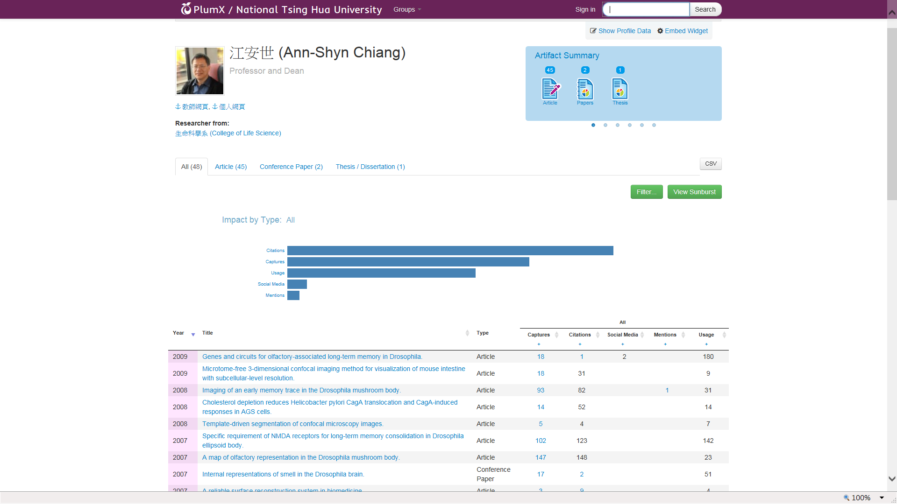
Researcher’s Portal
被引用次數
下載次數
社群關注
提及
使用
研發成果清單

Slide 18
查詢研究領域
搜尋「雲端」之研發領域
查得研發領域為「雲端」之相關教師

Slide 19
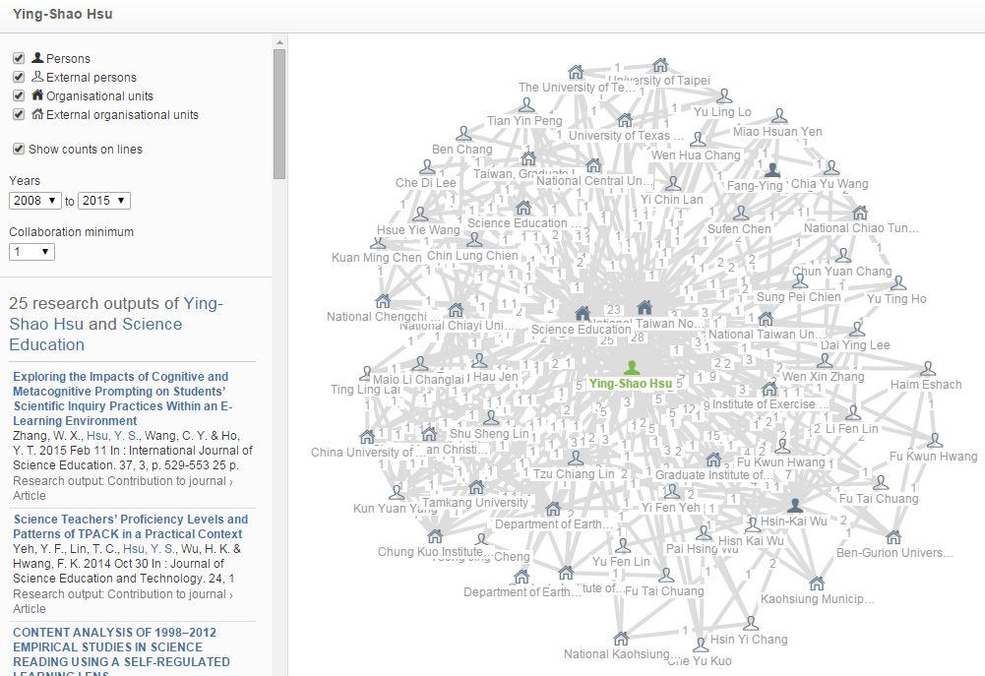
Collaborative networks

Slide 20
預期效益
強化清華校園跨領域的對話與合作
拓展清華之國際學術網絡
連結學術研究與產業與社會需求
充分使用圖書館之學術資源
成為知識創造與學習的活水源頭
成為清大對社會的價值共創者

Slide 21
清大圖書館活水計畫
半畝方塘一鑑開，
天光雲影共徘徊，
問渠那得清如許？
為有源頭活水來。
昨夜江邊春水生，艨艟巨艦一毛輕，向來枉費推移力，此日中流自在行。
(朱熹觀書有感)

Slide 22
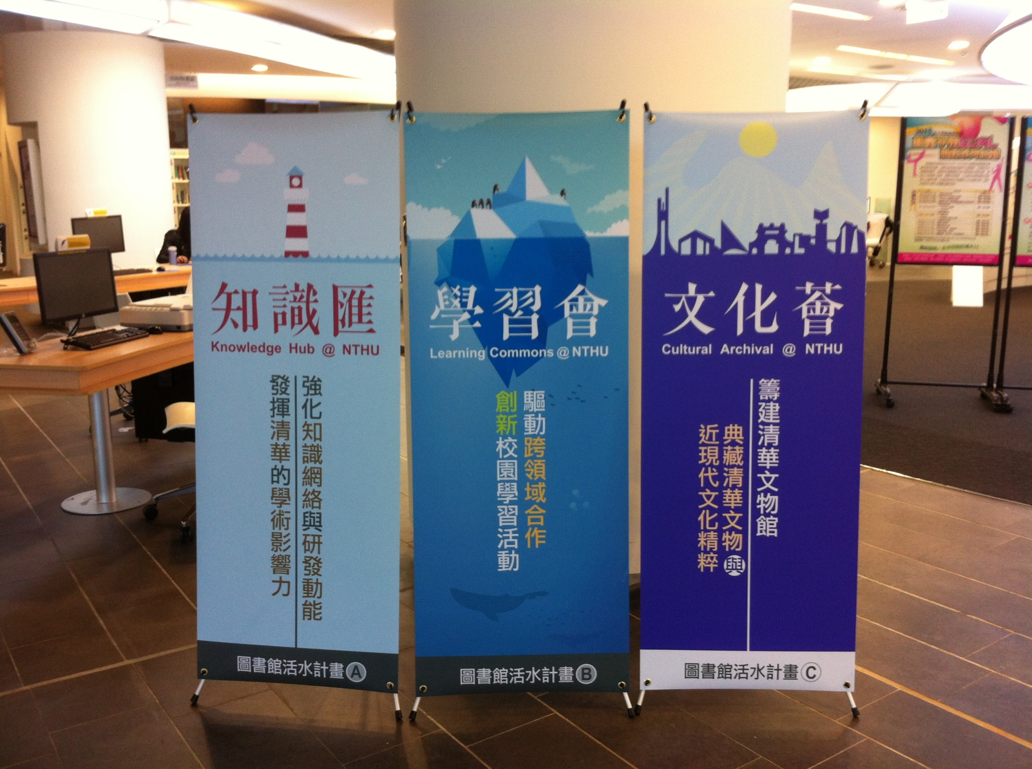

Slide 23
清大圖書館活水計畫
「知識匯」(Knowledge Hub @ NTHU)
「匯」是匯集、轉換與加值的樞紐
「學習會」(Learning Commons @ NTHU)
「會」是菁英之所聚與價值共創之場域
「文化薈」(Cultural Archival@ NTHU)
「薈」是文化精粹之典藏。

